Slide 1



E-Waste Generation Classification Using Machine Learning

Slide 2

Learning Objectives
To build a model that classifies types of e-waste based on generation patterns using machine learning, enabling efficient sorting and recycling.
GOAL
Source :
www.freepik.com/

Slide 3
Tools and Technology used
Python (Programming)Pandas, NumPy (Data Processing)Scikit-learn (ML Modeling)Jupyter Notebook (Development)Matplotlib/Seaborn (Visualization)

Slide 4
Methodology
Data Collection – Gather e-waste data from reliable sources.
Data Preprocessing – Clean, encode, normalize.
Model Selection – Decision Tree, Random Forest, SVM.
Training & Testing – Use train/test split, cross-validation
Evaluation – Accuracy, confusion matrix, F1 score.

Slide 5
Problem Statement:
E-waste is the fastest growing waste stream globally. Improper classification makes recycling inefficient and environmentally harmful. There's a need for a smart solution to classify e-waste automatically.

Slide 6
Solution:
A machine learning-based classification system that can:Identify e-waste types (e.g., small IT, large appliances).Classify based on material, device type, or source.Provide insights to optimize recycling and reduce landfill use.

Slide 7
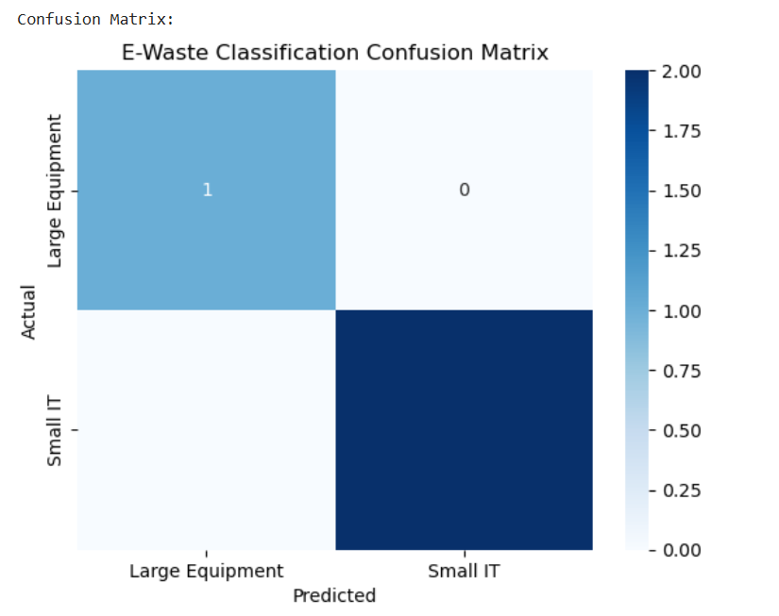
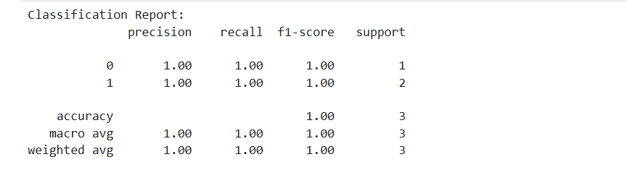
Screenshot of Output:

Slide 8
Conclusion:
E-waste classification using ML enhances recycling efficiency.Automating classification reduces human error.Helps policymakers and recyclers take informed decisions.Future scope: Real-time classification using sensors & IoT.

